Slide 1

VOTINGHUB – ONLINE VOTING SYSTEM
ONLINE VOTING SYSTEM WITH AADHAAR-STYLE OTP VERIFICATION
[FINAL REVIEW-2]
DATABASE SYSTEMS ENGINEERING AND DISTRIBUTED BACKEND DEVELOPMENT
COURSE CODE: 25CS1302E
SECTION: 12
TEAM NO.: 9
TEAM MEMBERS
2520090132 - KEERTHANA G.
2520090121 - THOTA JHANA SRI
2520090126 - SUTTE ALEKHYA

Slide 2
INTRODUCTION & OBJECTIVES
INTRODUCTION
OBJECTIVES
VOTINGHUB IS A WEB-BASED ONLINE VOTING SYSTEM.
PROVIDES DIGITAL VOTER REGISTRATION AND AUTHENTICATION.
OTP VERIFICATION ADDS AN ADDITIONAL AUTHENTICATION LAYER.
VERIFIED VOTERS CAN ACCESS THE VOTING INTERFACE.
ELECTIONS AND CANDIDATES ARE MANAGED THROUGH THE SYSTEM.
MAINTAINS CONTROLLED VOTING AND RESULT MANAGEMENT.
AUTHENTICATE VOTERS USING OTP VERIFICATION.
PROVIDE A SIMPLE ONLINE VOTING INTERFACE.
ALLOW ONLY VERIFIED VOTERS TO VOTE.
PREVENT MULTIPLE VOTING IN THE SAME ELECTION.
MAINTAIN ACCURATE VOTING RECORDS.
SIMPLIFY ELECTION AND RESULT MANAGEMENT.
KEY IDEA: SECURE AUTHENTICATION + DATABASE MANAGEMENT + ONLINE VOTING

Slide 3
FINAL SYSTEM ARCHITECTURE
REACT FRONTEND
:5174
AUTH SERVICE
:8081
ELECTION SERVICE
:8082
REST API
VOTING SERVICE
:8083
REGISTRATION
OTP
LOGIN
AUTHENTICATION
ELECTIONS
CANDIDATES
ELECTION STATUS
ELIGIBILITY
VOTE PROCESSING
DUPLICATE-VOTE PREVENTION
VOTING AUTHORIZATION
Voting Service → Election Service: services communicate through REST APIs; no service accesses another service's database directly.

Slide 4
DATABASE DESIGN
votehub_auth
votehub_election
votehub_voting
Users / Voter
identity, status, hashed password
Elections
election details and status
Voting Authorizations
per voter, per election; used flag
OTP Verifications
OTP code, expiry, attempts
Candidates
candidates per election (FK)
Votes
stored ballots
Sessions
login sessions
Election Events
election lifecycle events
Voting History
voter participation record
Notifications
user notifications
System Settings
system configuration
Audit Logs
audit trail of vote events
KEYS & RELATIONSHIPS
Every table has a primary key.
Candidates → Elections (foreign key).
OTP verifications → Users (foreign key).
Authorizations and votes are tied to an election.
Cross-service links are ID references, resolved through REST.
CONSTRAINTS & VOTE HANDLING
Voting authorization records whether a voter has voted.
Database constraints add duplicate-vote protection.
Authorization is stored separately from ballot data.
Each microservice owns its own logical database.

Slide 5
AUTHENTICATION & SECURITY
REGISTRATION & OTP
CREDENTIALS & ACCESS
VOTING INTEGRITY
VOTER REGISTRATION
OTP VERIFICATION
OTP EXPIRY
MAXIMUM OTP ATTEMPTS
RESEND INVALIDATES PREVIOUS OTP
BCRYPT PASSWORD HASHING
AUTHENTICATION (LOGIN)
AUTHORIZATION
PROTECTED AADHAAR REPRESENTATION
ELIGIBILITY VALIDATION
DUPLICATE-VOTE PREVENTION
CHECKS ENFORCED IN THE BACKEND
DEMO NOTICE
The Aadhaar-style OTP is a DEMO verification mechanism. It is NOT real UIDAI / Aadhaar integration.

Slide 6
VOTING WORKFLOW & DUPLICATE PREVENTION
1
LOGIN
2
SELECT ACTIVE ELECTION
3
ELIGIBILITY CHECK
4
AUTHORIZATION CHECK
5
SELECT CANDIDATE
6
SUBMIT VOTE
11
VOTE RECORDED
10
AUDIT EVENT
9
MARK AUTHORIZATION USED
8
STORE BALLOT
7
DUPLICATE-VOTE CHECK
BACKEND-ENFORCED RULES
VOTE STORAGE DESIGN
Backend is authoritative.
Frontend button disabling is not the security mechanism.
Voting authorization tracks whether the voter has already voted.
Database constraints give additional duplicate protection.
Voter authorization and ballot information are stored separately.
Authorization is marked used only after the ballot is stored.
Designed to separate who may vote from what was cast; not claimed as a cryptographic-grade secret ballot.

Slide 7
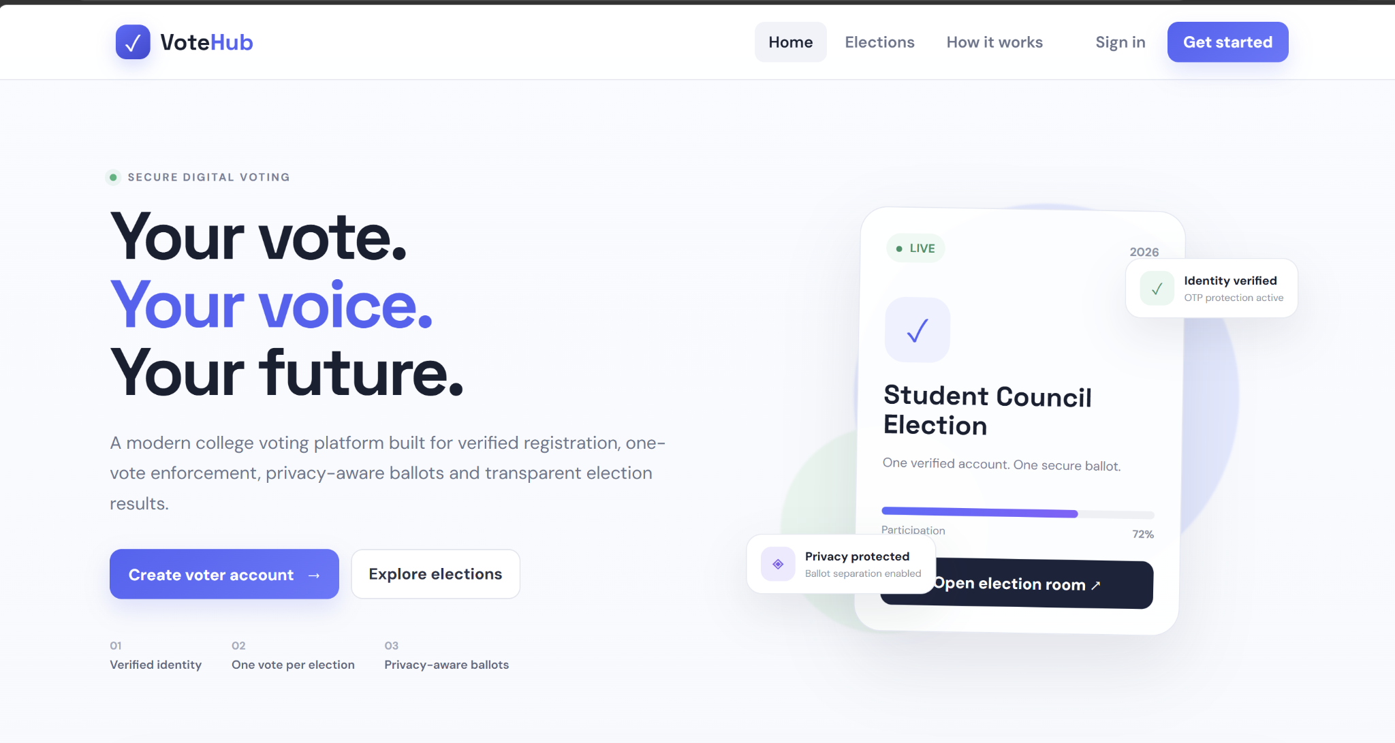
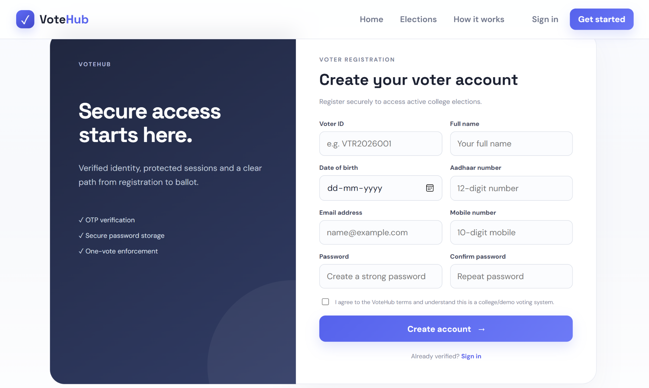
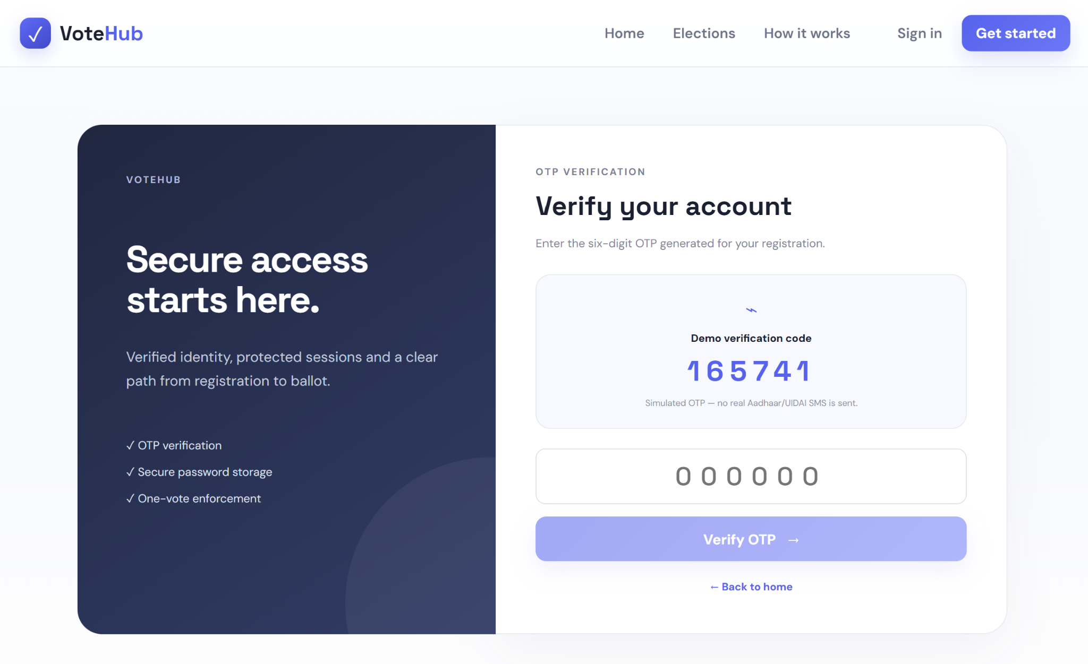
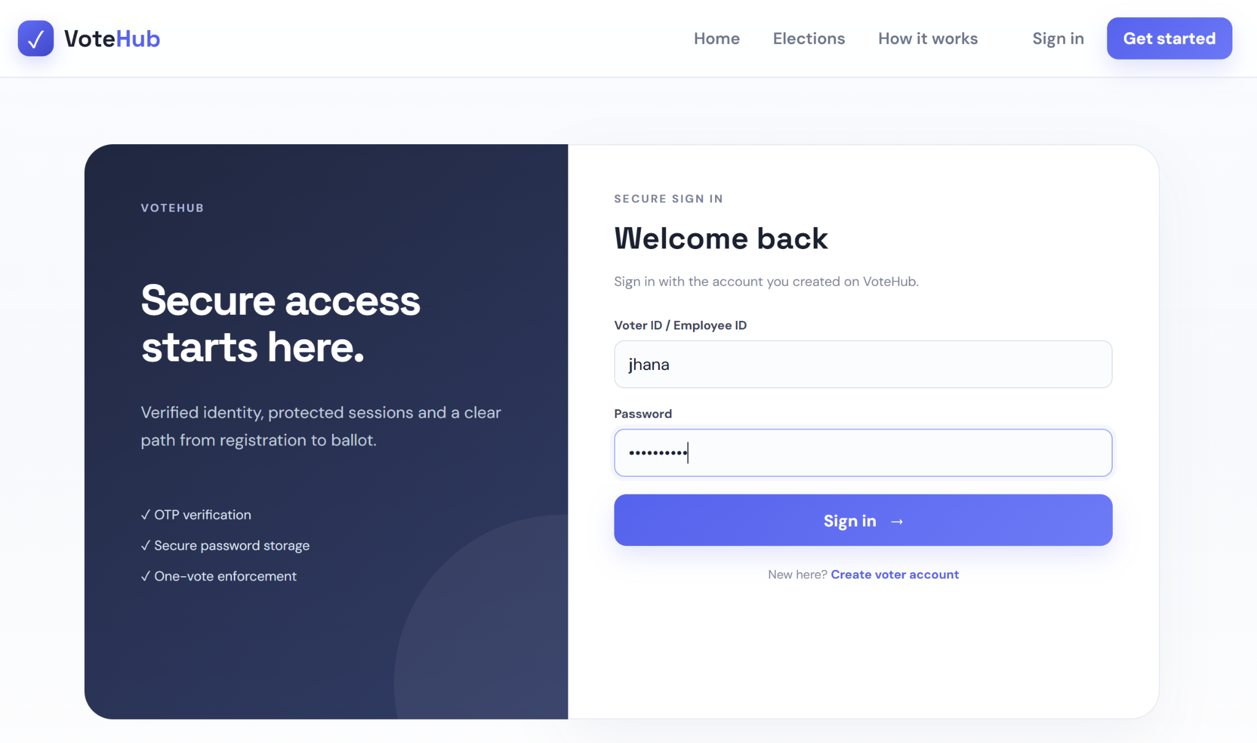
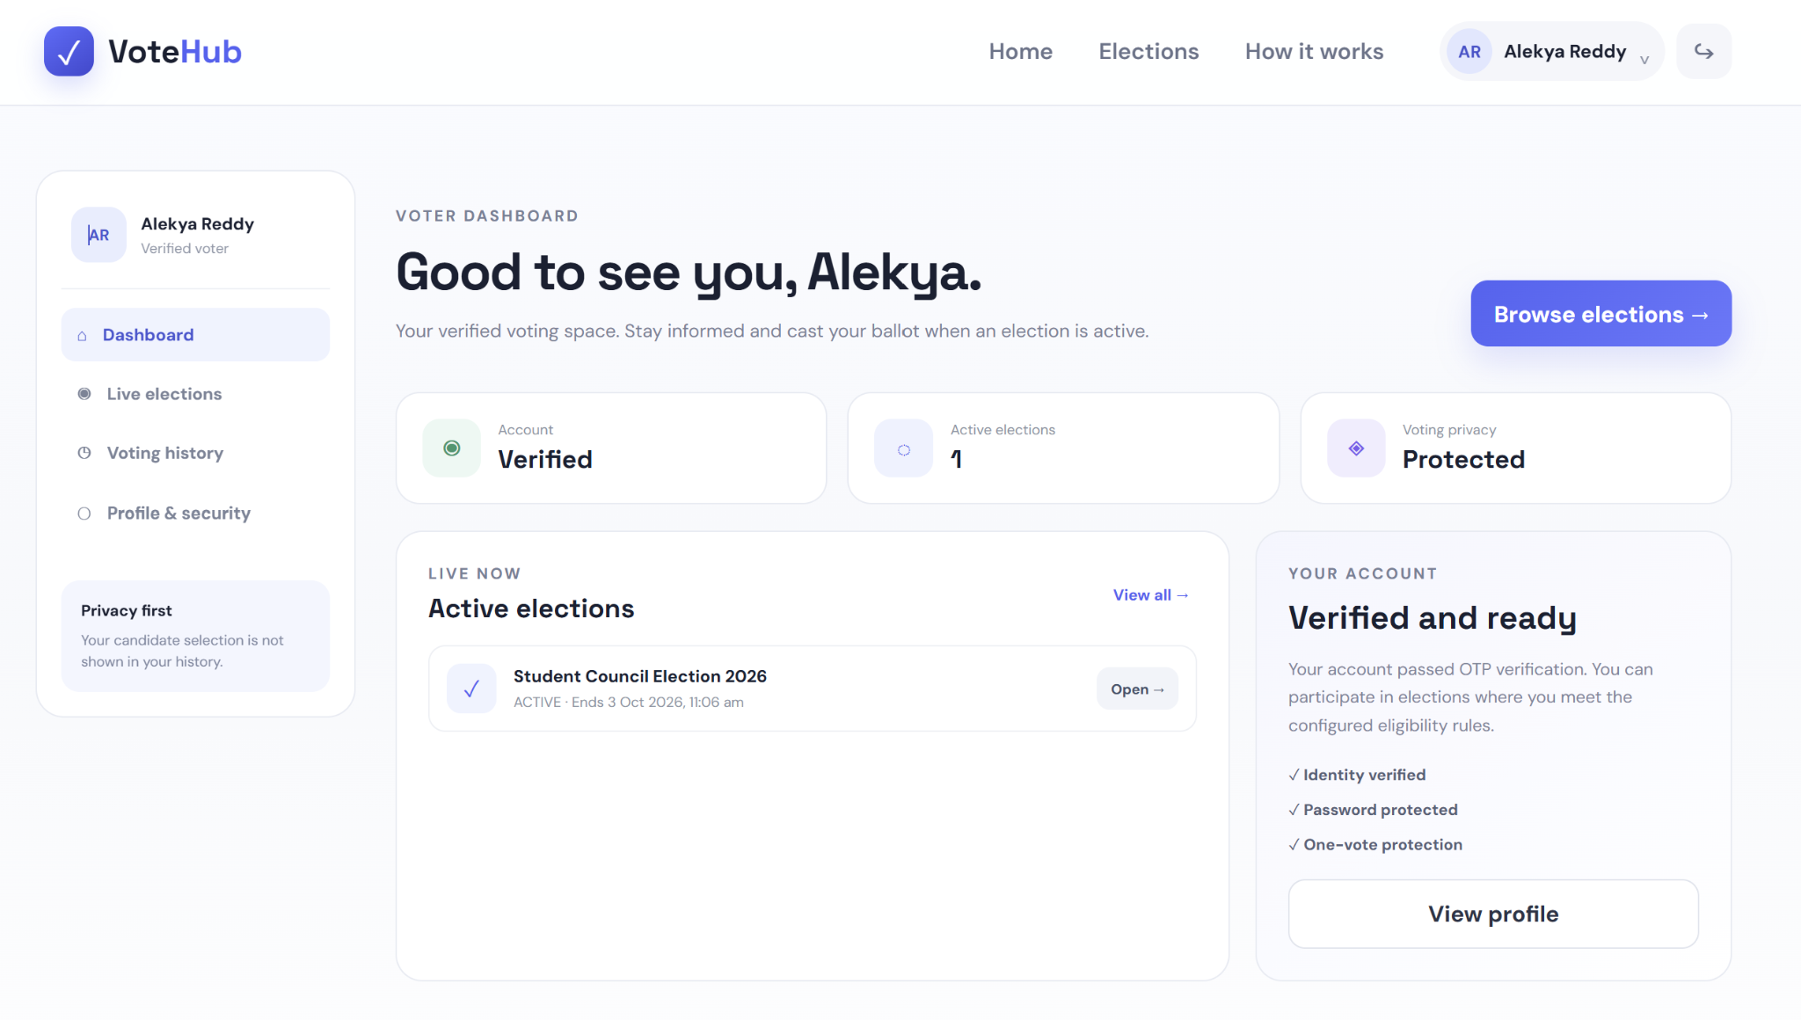
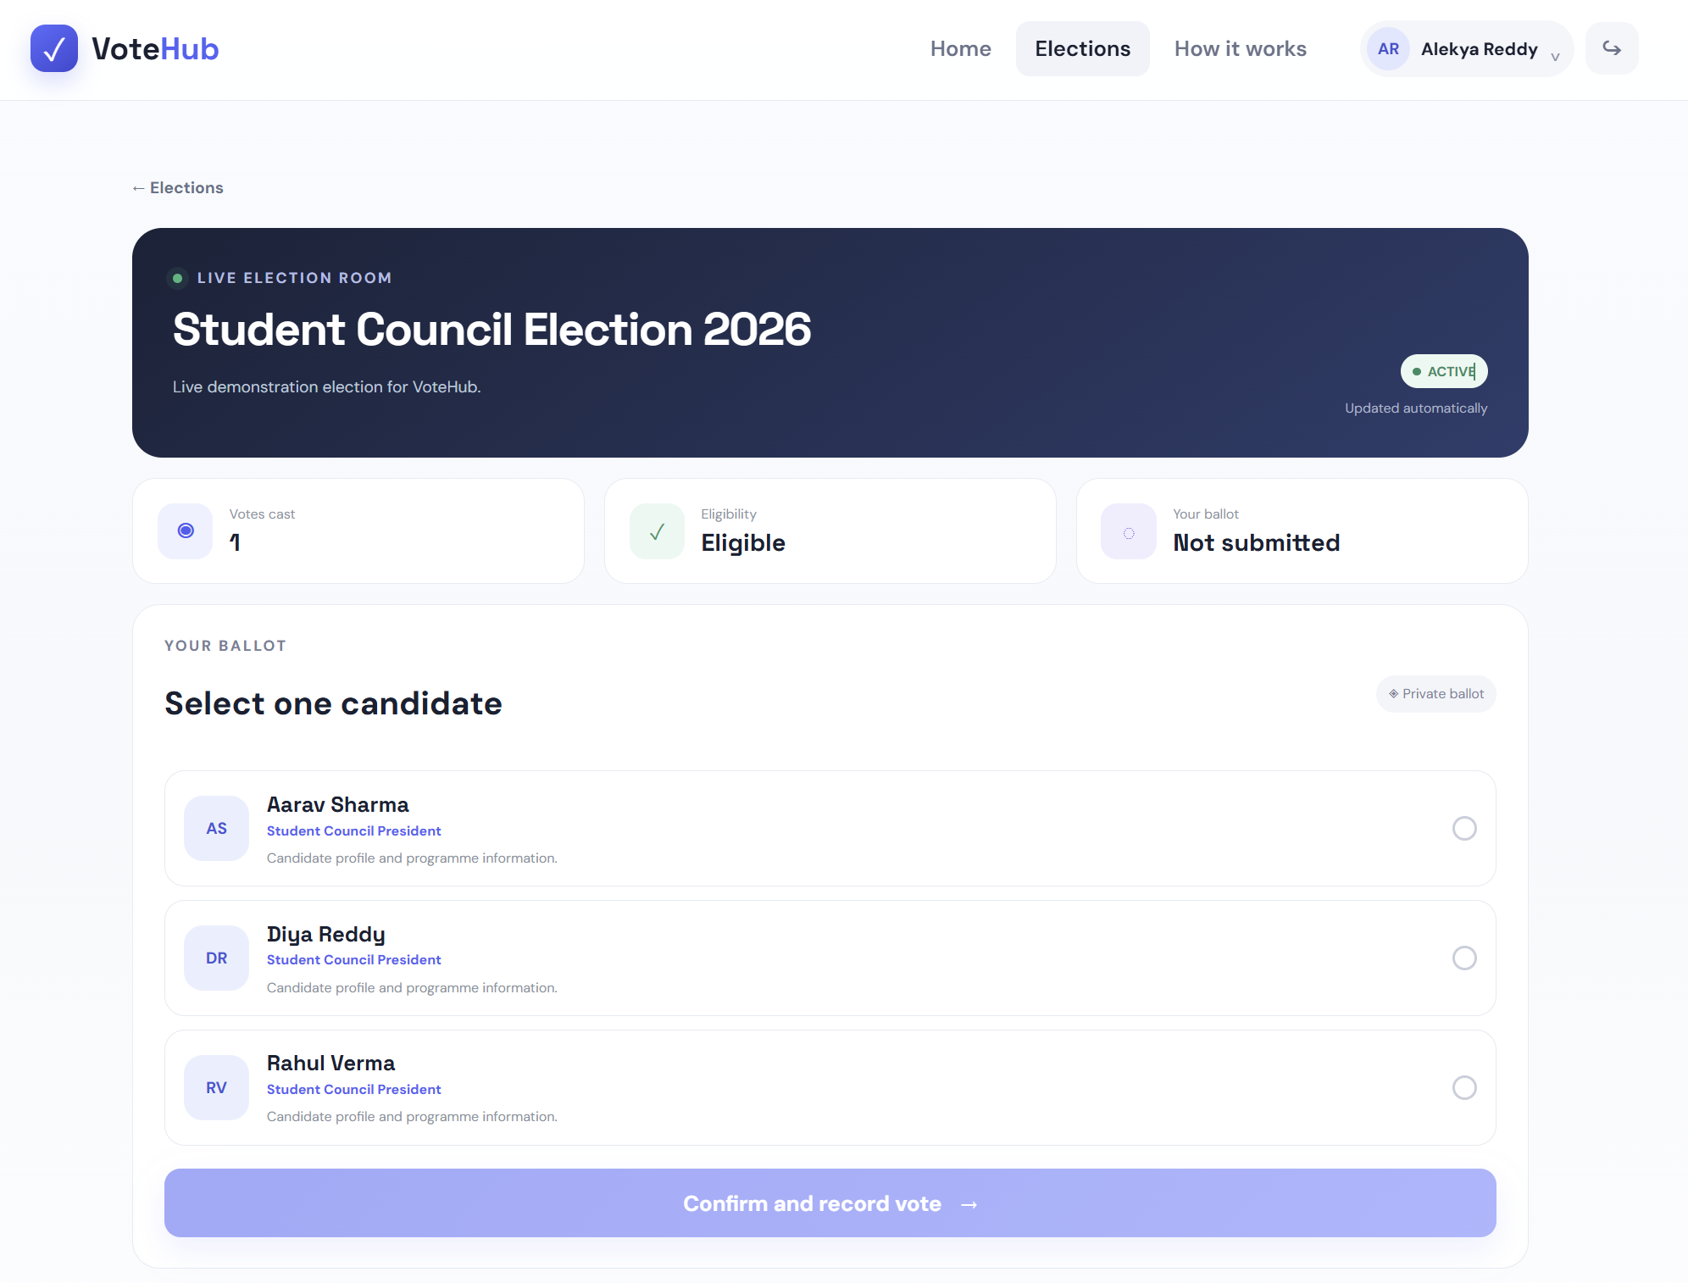
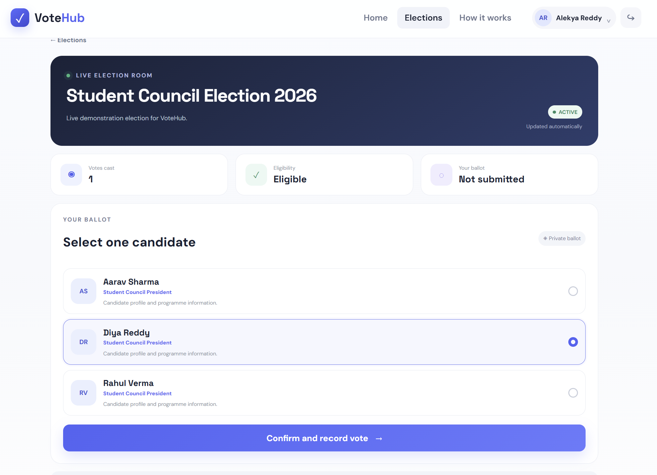
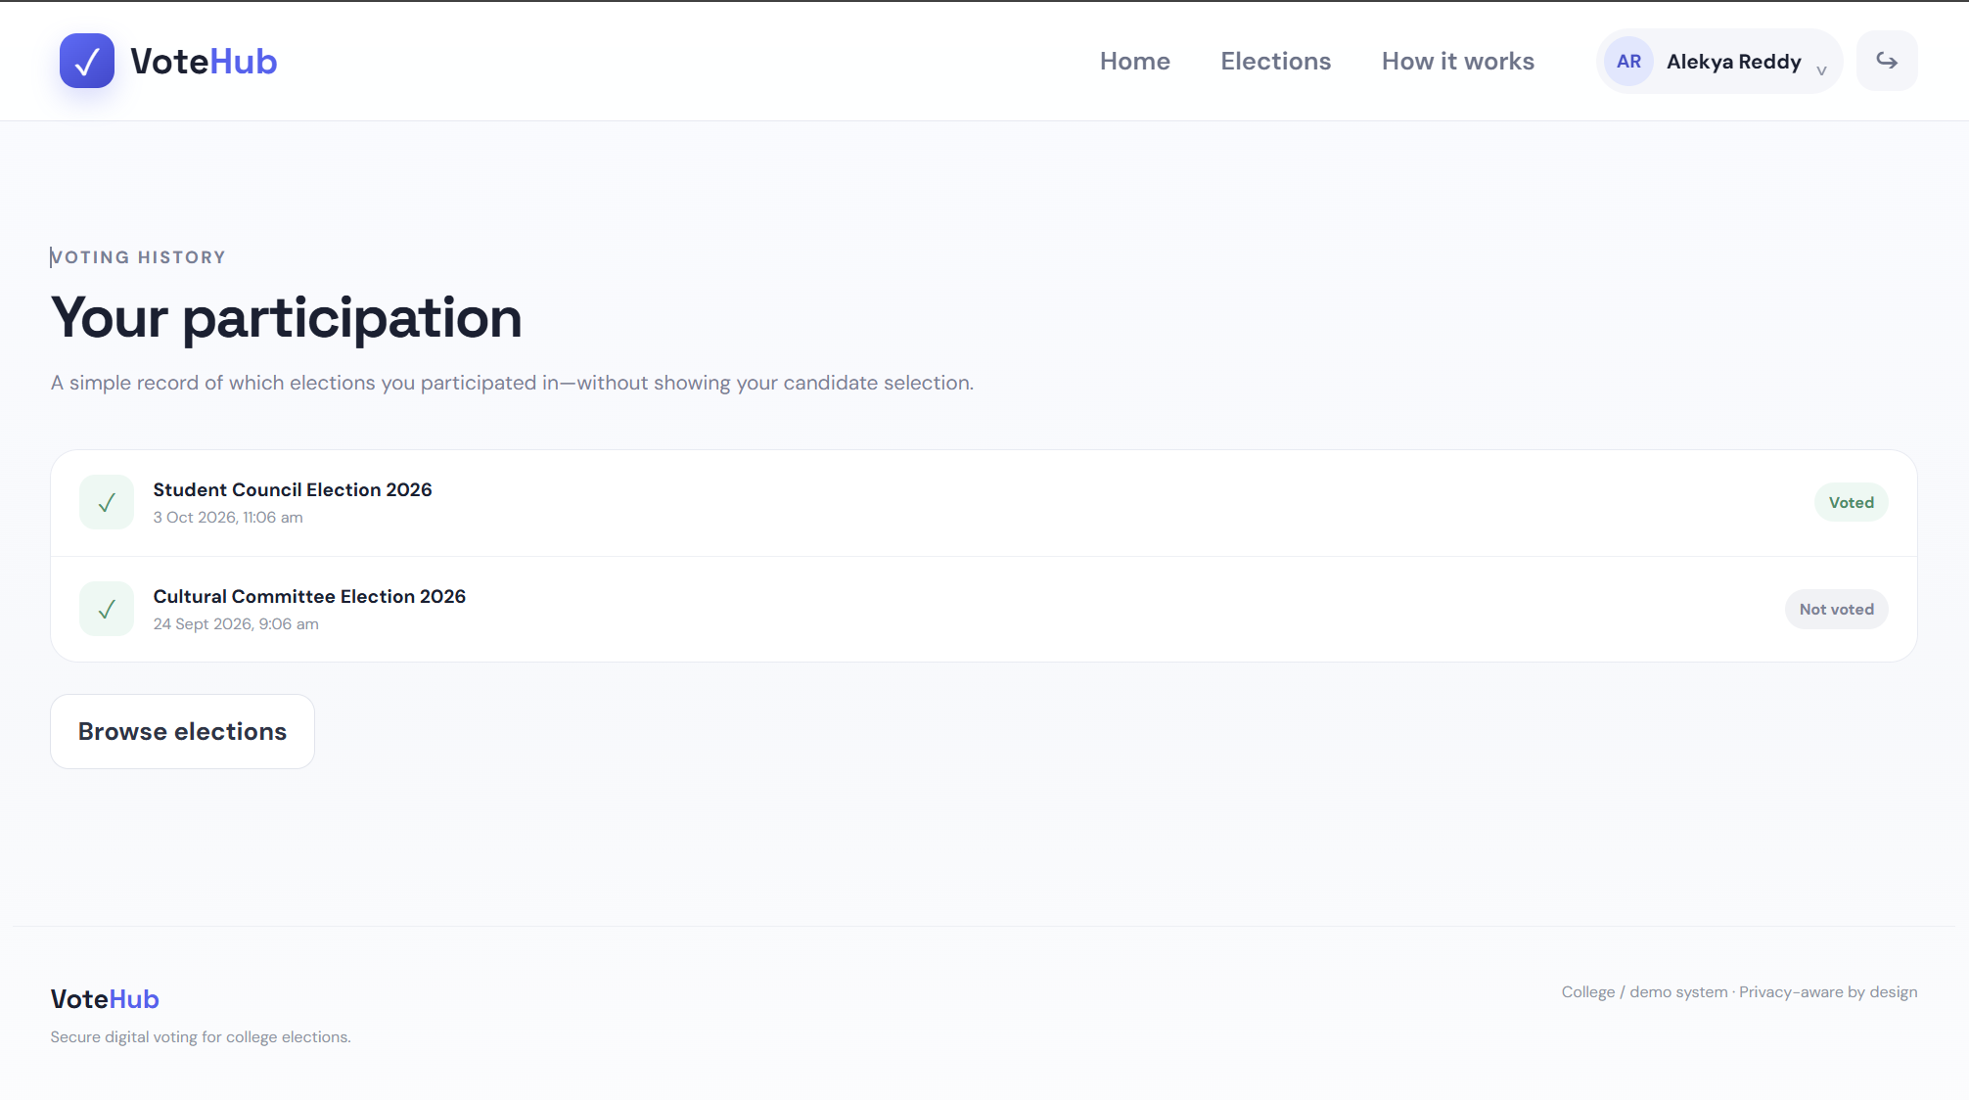
FINAL IMPLEMENTATION – VOTER INTERFACE
Insert actual screenshot
Insert actual screenshot
Insert actual screenshot
Insert actual screenshot
HOME PAGE
VOTER REGISTRATION
OTP VERIFICATION
LOGIN
Insert actual screenshot
Insert actual screenshot
Insert actual screenshot
Insert actual screenshot
VOTER DASHBOARD
LIVE / ACTIVE ELECTION
VOTING PAGE
VOTING HISTORY

Slide 8
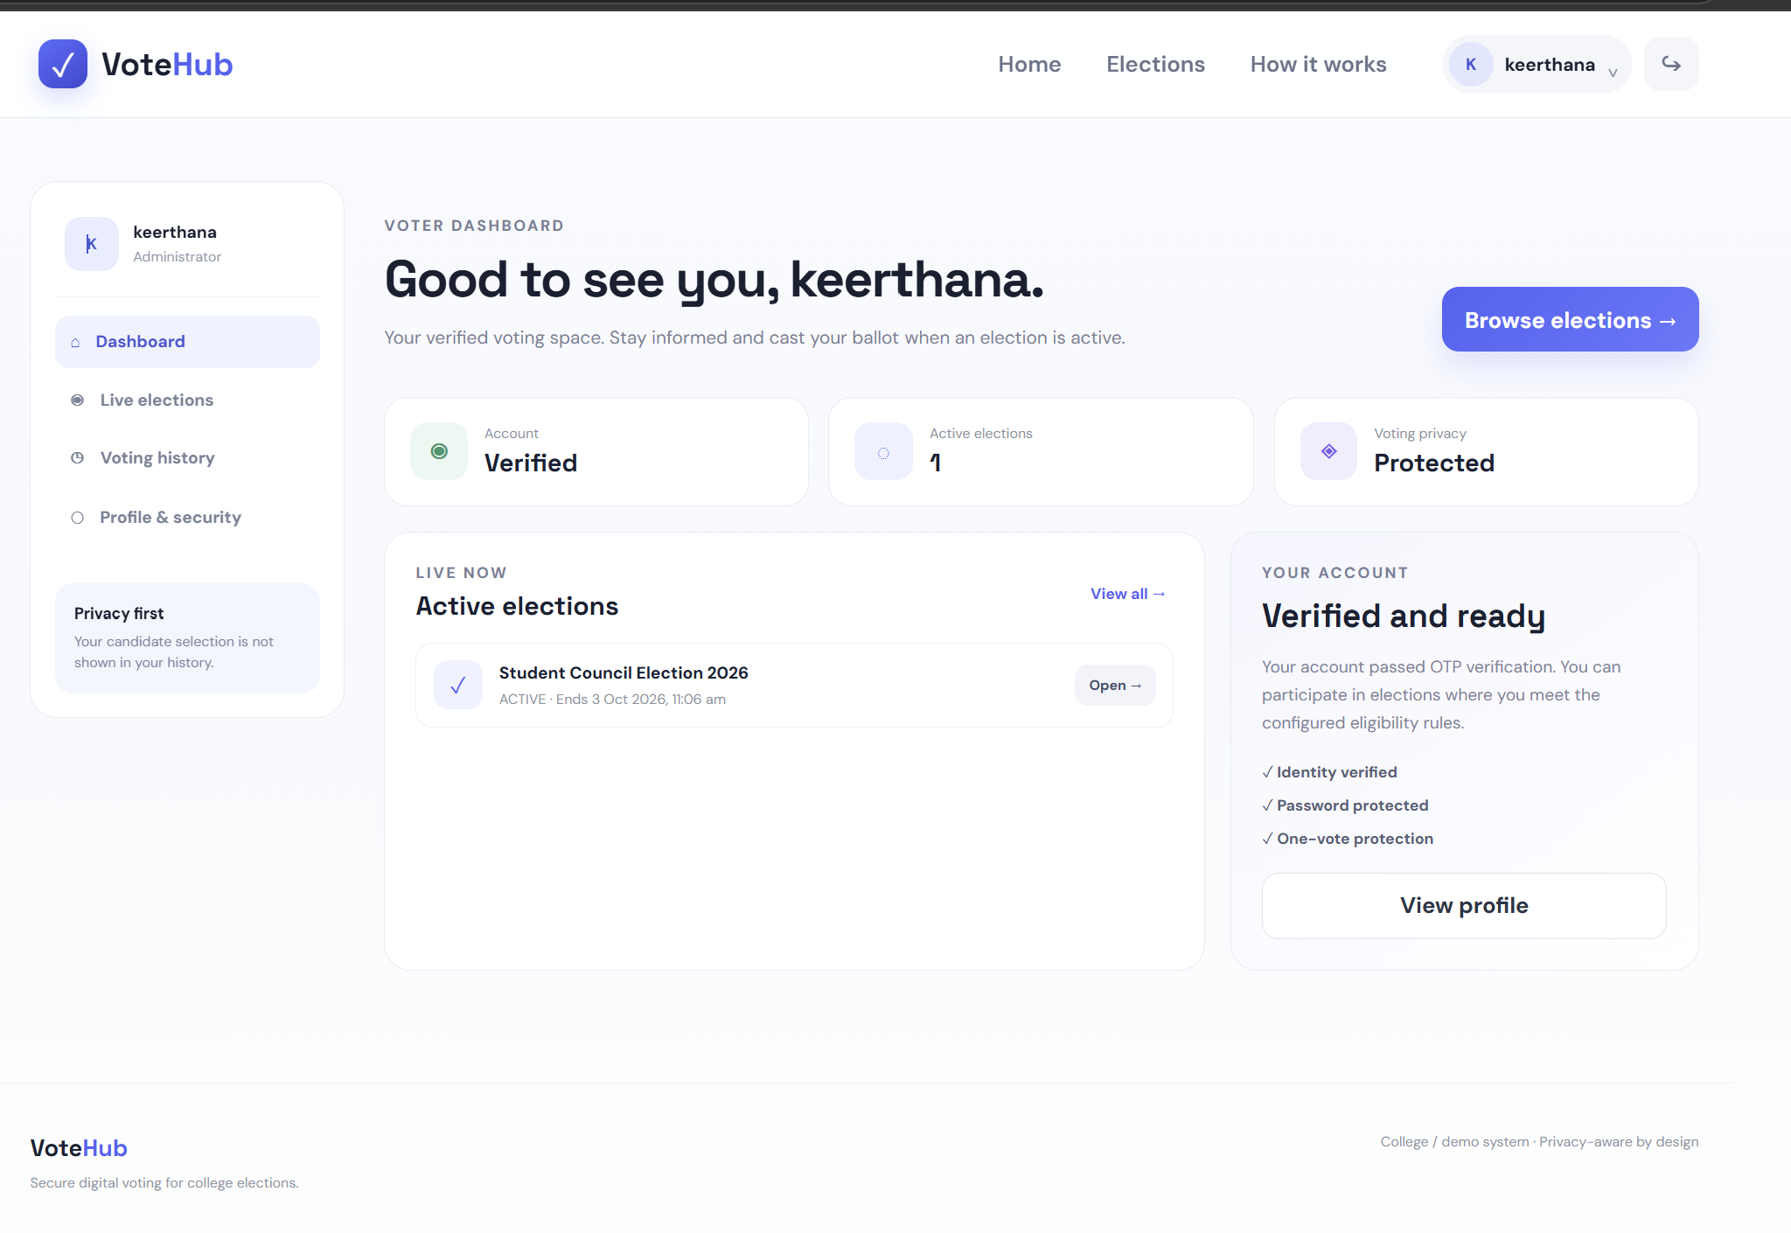
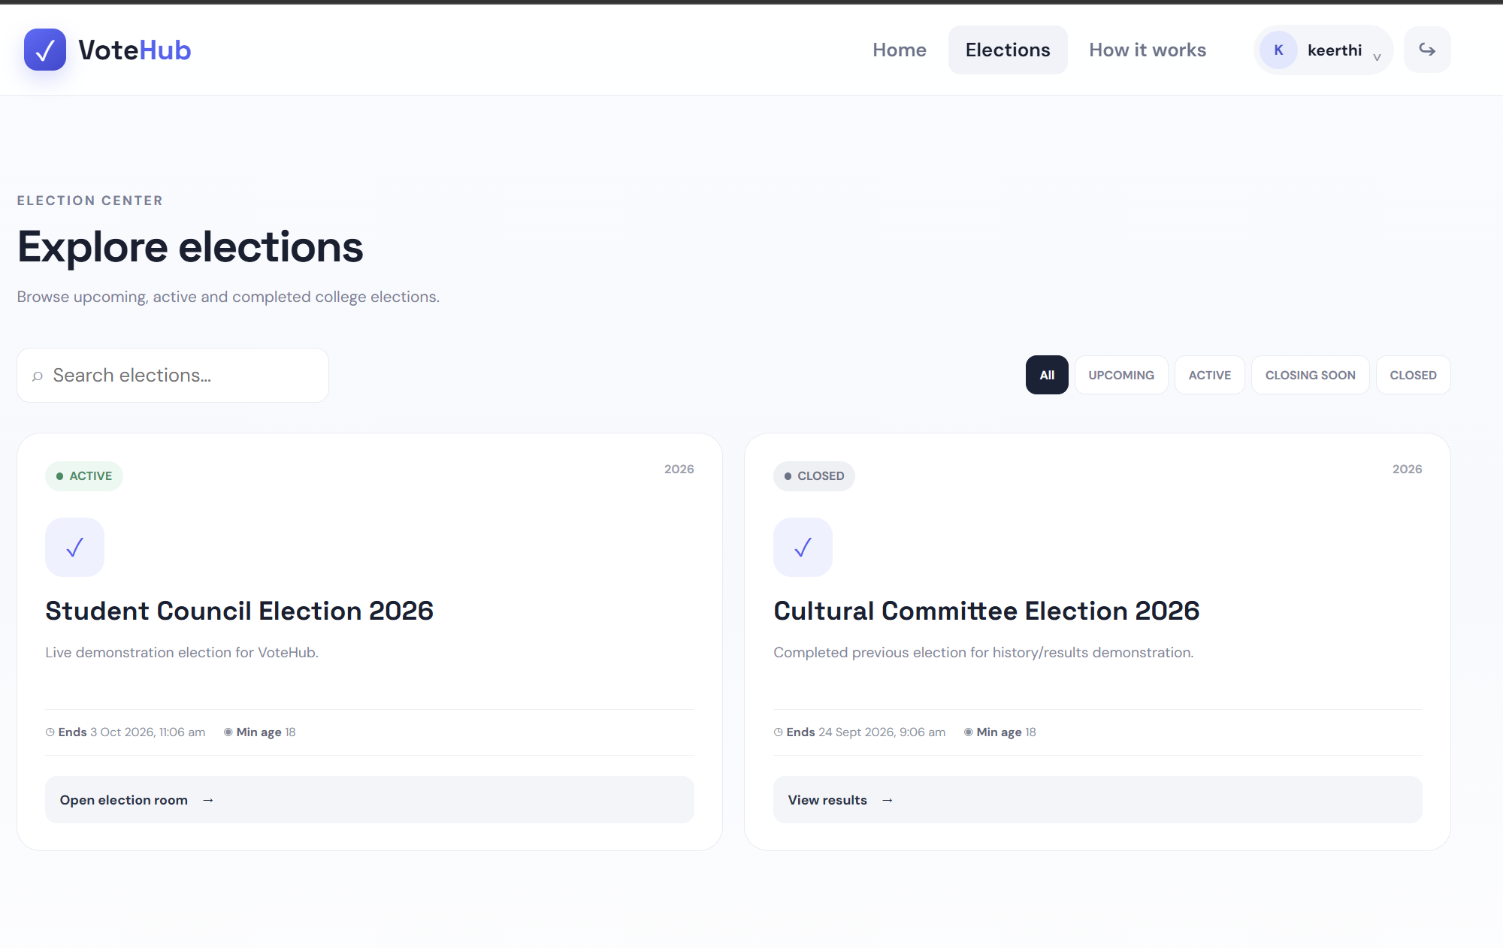
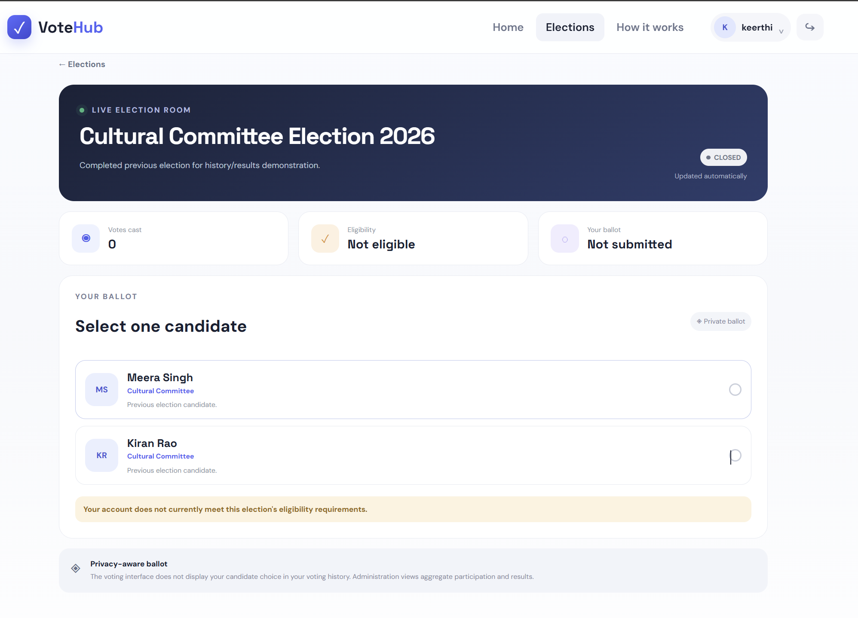
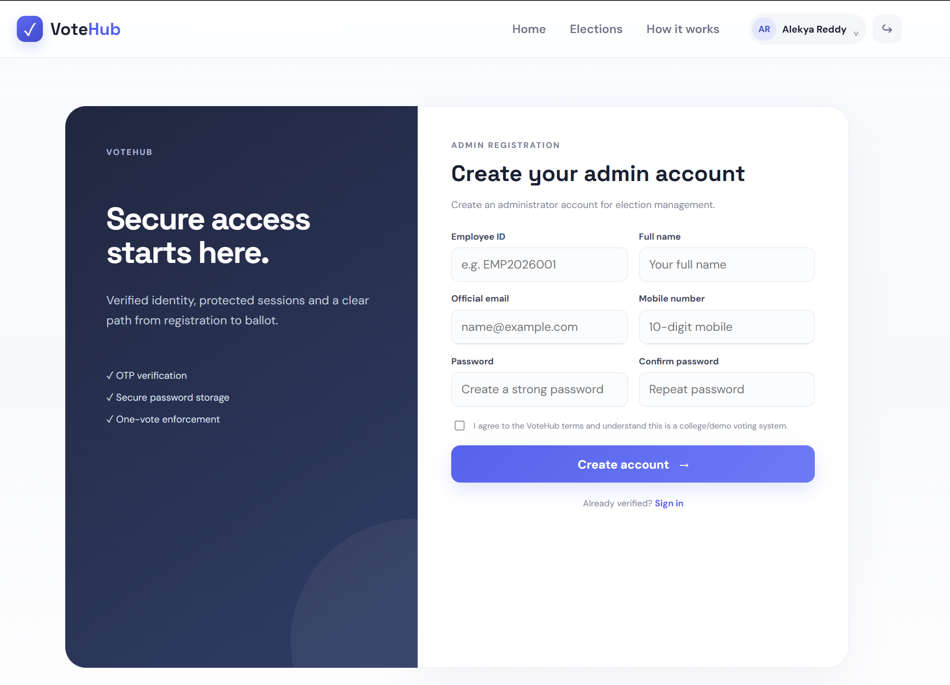
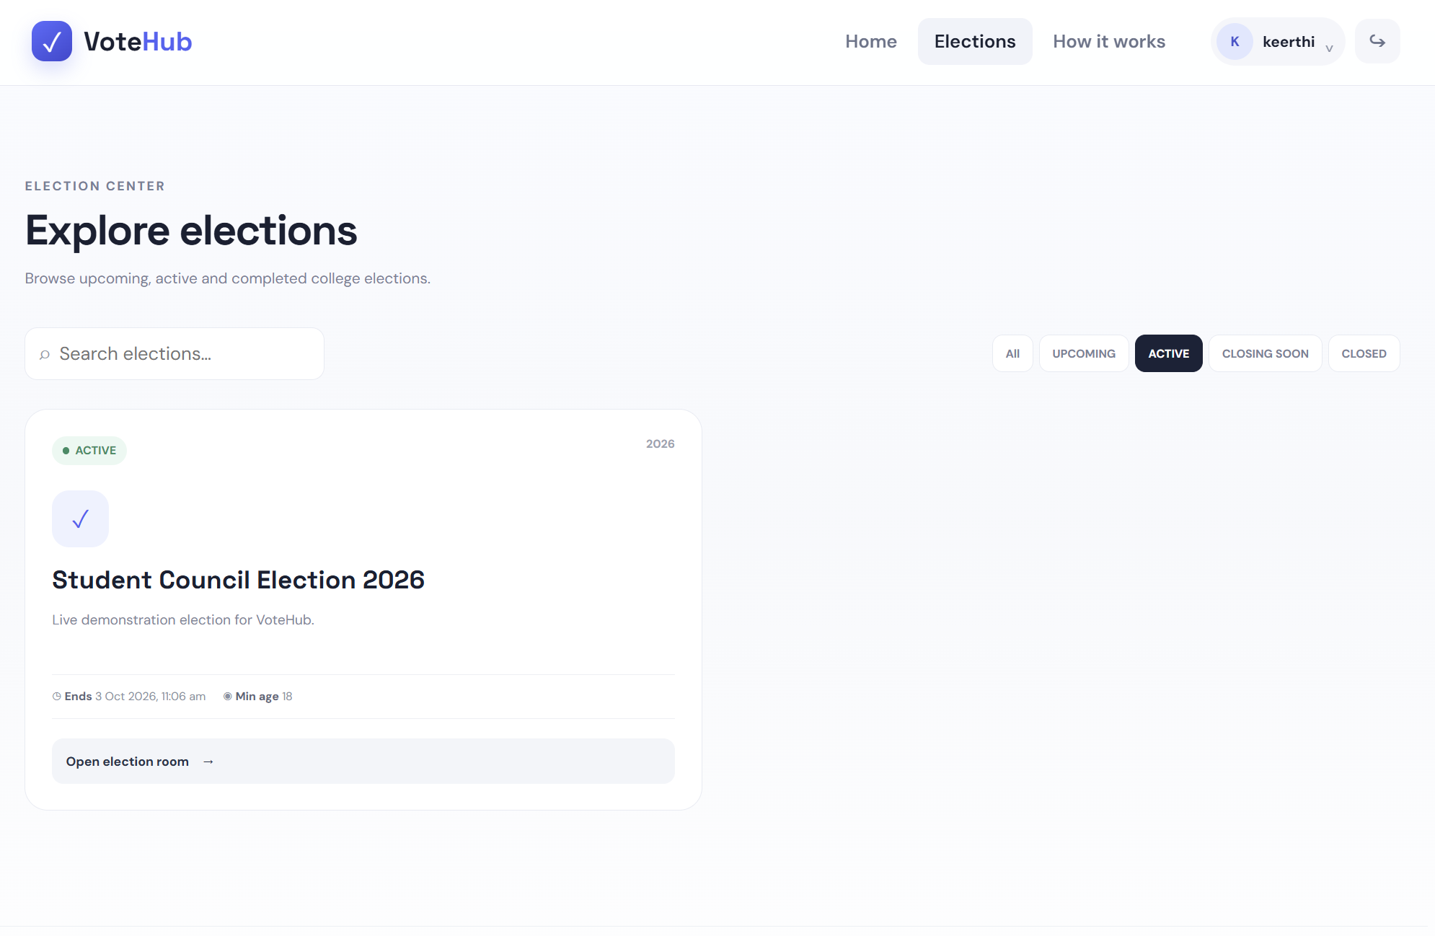
ADMIN MODULE & API / MICROSERVICE TESTING
ADMIN
ADMIN DASHBOARD
ELECTION MANAGEMENT
CANDIDATE MANAGEMENT
AUDIT LOGS
RESULTS

Slide 9
TESTING, RESULTS & TEAM CONTRIBUTION
TEST CASE | EXPECTED RESULT | STATUS
Valid registration | Voter account created, OTP issued | TO CONFIRM
OTP verification | Correct OTP verifies the voter | TO CONFIRM
Login | Verified voter logs in | TO CONFIRM
Election retrieval | Elections returned by Election Service | TO CONFIRM
Candidate retrieval | Candidates of an election returned | TO CONFIRM
Valid vote | Ballot stored, authorization marked used | TO CONFIRM
Duplicate vote | Second vote in same election rejected | TO CONFIRM
Closed election | Voting on closed election rejected | TO CONFIRM
Results | Vote counts shown for the election | TO CONFIRM
PROJECT RESULTS
WORKING WEB-BASED VOTING WORKFLOW
AUTHENTICATION AND OTP VERIFICATION
ELECTION AND CANDIDATE MANAGEMENT
CONTROLLED VOTING ACCESS
DUPLICATE-VOTE PREVENTION
MICROSERVICE-BASED BACKEND ARCHITECTURE
TEAM CONTRIBUTIONS
TEAM MEMBER | CONTRIBUTION
Keerthana G. | [to be added by team]
Thota Jhana Sri | [to be added by team]
Sutte Alekhya | [to be added by team]

Slide 10
CONCLUSION & FUTURE SCOPE
CONCLUSION
FUTURE SCOPE
VotingHub provides a structured digital voting workflow combining:
REAL-TIME UPDATES USING WEBSOCKET/SSE
DOCKER/CONTAINER DEPLOYMENT
CLOUD DEPLOYMENT
ENHANCED MONITORING
STRONGER IDENTITY-PROVIDER INTEGRATION
FURTHER SECURITY ENHANCEMENTS
REACT FRONTEND
SPRING BOOT BACKEND
MYSQL DATABASE
OTP-BASED AUTHENTICATION
CONTROLLED VOTING ACCESS
DUPLICATE-VOTE PREVENTION
ELECTION AND RESULT MANAGEMENT
CO6 MICROSERVICES ARCHITECTURE
QR CODE
(insert)
GitHub: https://github.com/Jhanasri-thota/DBS-DS_PROJECT
Team No. 9 | Section 12 | 25CS1302E
Keerthana G. • Thota Jhana Sri • Sutte Alekhya
THANK YOU

